Slide 1
Lecture 7
Regression

Slide 2
Introduction

Slide 3
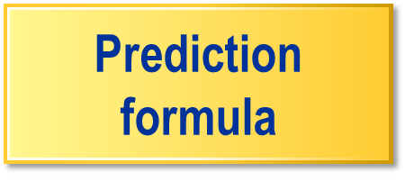
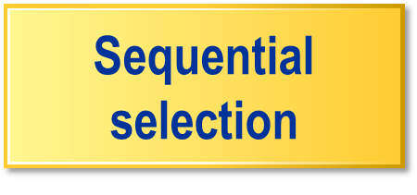

Model Essentials – Regressions
Predict new cases.
Select useful inputs.
Optimize complexity.
...

Slide 4

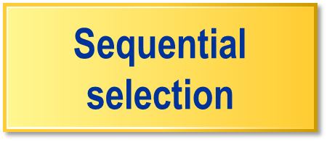


Model Essentials – Regressions
Predict new cases.
Sequential
selection
Select useful inputs.
Select useful inputs
Best model
from sequence
Optimize complexity.
Optimize complexity
...

Slide 5
Model Essentials – Regressions
Predict new cases.
Sequential
selection
Select useful inputs.
Best model
from sequence
Optimize complexity.

Slide 6
Linear/ Logistic Regression
  Linear Regression : continuous target 변수값을 추정하는 작업
  Logistic Regression : 범주형 변수에서 각 범주에 속할 확률을 산정/예측하는 작업
  linear regression과 logistic regression에서 input 변수로 continuous, binary, nominal, ordinary 변수 등이 가능하나 continuous 변수가 아닌 경우 변수를 재구성할 필요가 있다. (Enterprise Miner에서는 자동적으로 수행된다.)

Slide 7
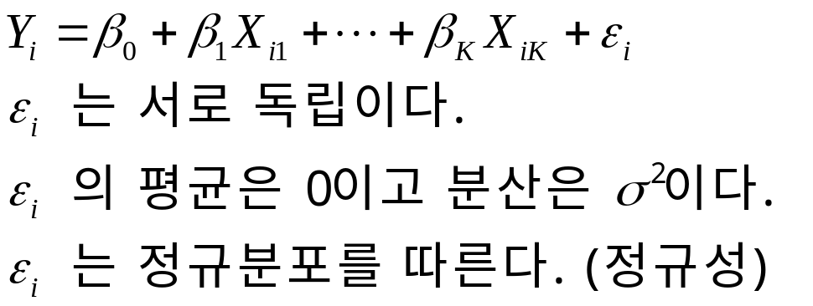




Linear regression model
linear regression에서는 continuous target변수와 input변수가 주어질 때 상수 를 추정하게 된다.
모형에서 상수 의 의미는 다른 변수들이 고정되어 있을 경우 input 변수 가 1단위 증가할 때 target변수 의 증가분을 나타낸다.
proc reg … ;
run;

Slide 8
Linear Regression Prediction Formula
input
measurement
^
^
^
^
y
= w₀ + w₁ x₁ + w₂ x₂
prediction
estimate
·
·
intercept
estimate
parameter
estimate
Choose intercept and parameter estimates to minimize:
squared error function
^
∑( y_{i} – y_{i} )²
training
data
...

Slide 9
Linear Regression Prediction Formula
input
measurement
^
^
^
^
y
= w₀ + w₁ x₁ + w₂ x₂
prediction
estimate
·
·
intercept
estimate
parameter
estimate
Choose intercept and parameter estimates to minimize.
squared error function
^
∑( y_{i} – y_{i} )²
training
data
...

Slide 10




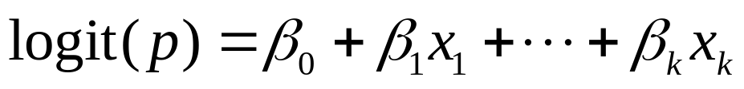
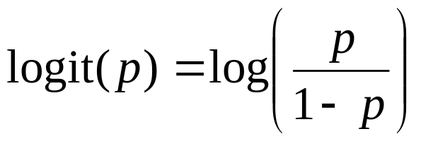
Logistic regression model
확률은 0과 1 사이의 값이므로 이론상으로 input 변수의 선형 함수로 나타낼 수 없다. 따라서 확률값 자체 대신 확률값의 함수를 이용한다.
종속변수 | 확률
1
0
proc logistic … ;
run;

Slide 11
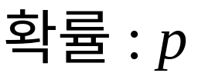
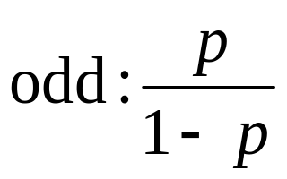
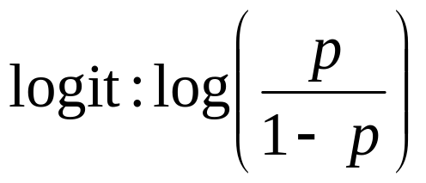
확률, odd, logit
0
½
1
0
1
+∞
–∞
0
+∞
0

Slide 12
Logistic Regression Prediction Formula
p
1 – p
(
^
)
^
^
^
log
= w₀ + w₁ x₁ + w₂ x₂
·
·
logit scores
^
...

Slide 13
Logit Link Function
p
1 – p
(
^
)
^
^
^
log
= w₀ + w₁ x₁ + w₂ x₂
·
·
logit scores
^
logit
link function
5
The logit link function transforms probabilities (between 0 and 1) to logit scores (between −∞ and +∞).
0
1
-5
...

Slide 14
Logit Link Function
p
1 – p
(
^
)
^
^
^
log
= w₀ + w₁ x₁ + w₂ x₂
·
·
logit scores
^
logit
link function
5
The logit link function transforms probabilities (between 0 and 1) to logit scores (between −∞ and +∞).
0
1
-5
...

Slide 15
Logit Link Function
p
1 – p
(
^
)
^
^
^
^
log
= w₀ + w₁ x₁ + w₂ x₂
=
logit( p )
·
·
^
logit scores
1
1 + e^{-logit( p )}
^
p =
^
^
To obtain prediction estimates, logit equation is solved for p.
...

Slide 16
Logit Link Function
p
1 – p
(
^
)
^
^
^
^
log
= w₀ + w₁ x₁ + w₂ x₂
=
logit( p )
·
·
^
logit scores
1
1 + e^{-logit( p )}
^
p =
^
^
To obtain prediction estimates, logit equation is solved for p.
...

Slide 17

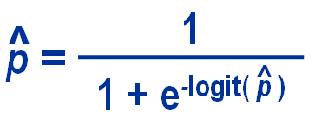
Logit Link Function
logit scores
...

Slide 18
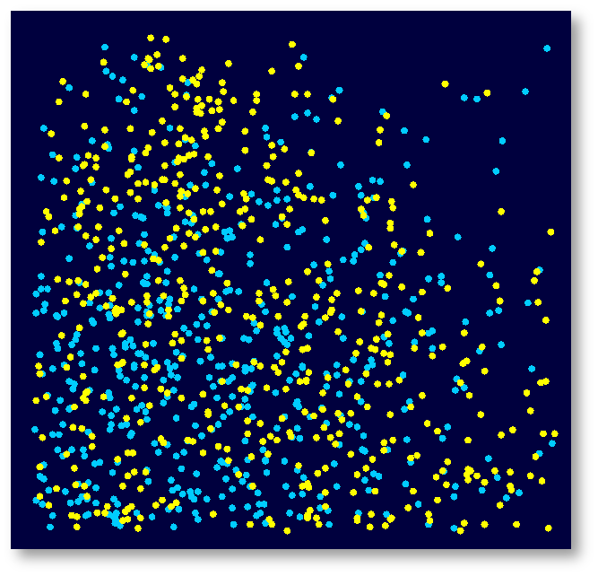

Simple Prediction Illustration – Regressions
Predict dot color for each x₁ and x₂.
1.0
0.9
0.8
0.7
0.6
x₂
0.5
Need intercept and parameter estimates.
0.4
0.3
0.2
0.1
0.0
0.0
0.1
0.2
0.3
0.4
0.5
0.6
0.7
0.8
0.9
1.0
x₁
...

Slide 19
Simple Prediction Illustration – Regressions
Predict dot color for each x₁ and x₂.
1.0
0.9
0.8
0.7
0.6
x₂
0.5
Need intercept and parameter estimates.
0.4
0.3
0.2
0.1
0.0
0.0
0.1
0.2
0.3
0.4
0.5
0.6
0.7
0.8
0.9
1.0
x₁
...

Slide 20
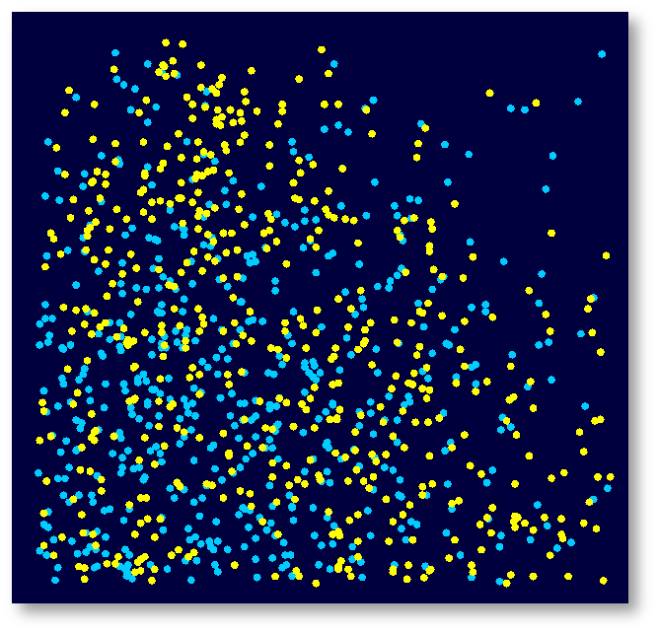
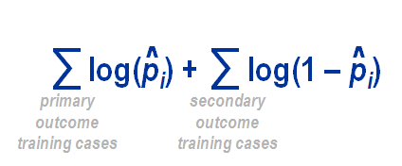
Simple Prediction Illustration – Regressions
1.0
0.9
0.8
0.7
0.6
x₂
0.5
Find parameter estimates by maximizing
0.4
0.3
0.2
0.1
0.0
log-likelihood function
0.0
0.1
0.2
0.3
0.4
0.5
0.6
0.7
0.8
0.9
1.0
x₁
...

Slide 21
Simple Prediction Illustration – Regressions
1.0
0.9
0.8
0.7
0.6
x₂
0.5
Find parameter estimates by maximizing
0.4
0.3
0.2
0.1
0.0
log-likelihood function
0.0
0.1
0.2
0.3
0.4
0.5
0.6
0.7
0.8
0.9
1.0
x₁
...

Slide 22



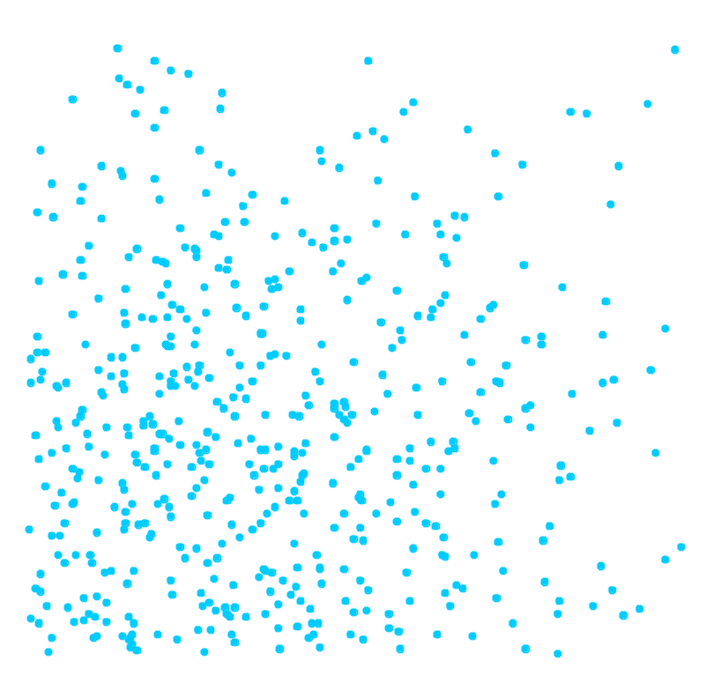

Simple Prediction Illustration – Regressions
1.0
0.9
0.8
0.70
0.7
0.6
x₂
0.5
0.60
Using the maximum likelihood estimates, the prediction formula assigns a logit score to each x₁ and x₂.
0.4
0.3
0.50
0.2
0.1
0.40
0.0
0.0
0.1
0.2
0.3
0.4
0.5
0.6
0.7
0.8
0.9
1.0
x₁
...

Slide 23
Selecting Regression Inputs

Slide 24

Model Essentials – Regressions
Prediction
formula
Predict new cases.
Sequential
selection
Select useful inputs.
Select useful inputs
Best model
from sequence
Optimize complexity.

Slide 25
Sequential Selection – Forward
Input p-value
Entry Cutoff
...

Slide 26
Sequential Selection – Forward
Input p-value
Entry Cutoff
...

Slide 27
Sequential Selection – Forward
Input p-value
Entry Cutoff
...

Slide 28
Sequential Selection – Forward
Input p-value
Entry Cutoff

Slide 29
Sequential Selection – Forward
Input p-value
Entry Cutoff

Slide 30
Sequential Selection – Backward
Input p-value
Stay Cutoff
...

Slide 31
Sequential Selection – Backward
Input p-value
Stay Cutoff
...

Slide 32
Sequential Selection – Backward
Input p-value
Stay Cutoff
...

Slide 33
Sequential Selection – Backward
Input p-value
Stay Cutoff
...

Slide 34
Sequential Selection – Backward
Input p-value
Stay Cutoff
...

Slide 35
Sequential Selection – Backward
Input p-value
Stay Cutoff
...

Slide 36
Sequential Selection – Backward
Input p-value
Stay Cutoff

Slide 37
Sequential Selection – Backward
Input p-value
Stay Cutoff

Slide 38
Sequential Selection – Stepwise
Input p-value
Entry Cutoff
Stay Cutoff
...

Slide 39
Sequential Selection – Stepwise
Input p-value
Entry Cutoff
Stay Cutoff
...

Slide 40
Sequential Selection – Stepwise
Input p-value
Entry Cutoff
Stay Cutoff
...

Slide 41
Sequential Selection – Stepwise
Input p-value
Entry Cutoff
Stay Cutoff
...

Slide 42
Sequential Selection – Stepwise
Input p-value
Entry Cutoff
Stay Cutoff

Slide 43
Sequential Selection – Stepwise
Input p-value
Entry Cutoff
Stay Cutoff

Slide 44
Sequential Selection – Stepwise
Input p-value
Entry Cutoff
Stay Cutoff

Slide 45
Optimizing Regression Complexity

Slide 46

Model Essentials – Regressions
Prediction
formula
Predict new cases.
Sequential
selection
Select useful inputs.
Optimize complexity.
...

Slide 47
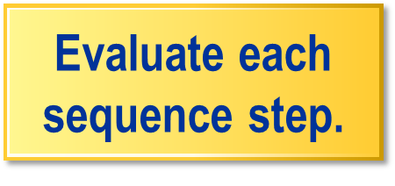
Model Fit versus Complexity
Model fit statistic
validation
training
1
2
3
4
5
6
...

Slide 48
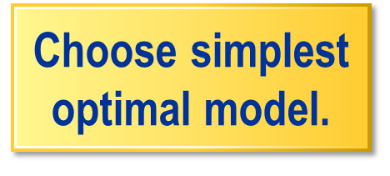
Select Model with Optimal Validation Fit
Model fit statistic
Evaluate each
sequence step.
1
2
3
4
5
6
...

Slide 49
Interpreting Regression Models

Slide 50
Logistic Regression Prediction Formula
p
1 – p
(
^
)
log
^
^
^
= w₀ + w₁ x₁ + w₂ x₂
·
·
logit scores
^
...

Slide 51

Odds Ratios and Doubling Amounts
p
1 – p
(
^
)
log
^
^
^
= w₀ + w₁ x₁ + w₂ x₂
·
·
logit scores
^
Δx_{i} consequence
Odds ratio: Amount odds change with unit change in input.
1 ⇒ odds × exp(w_{i})
Doubling amount:
Input change is required
to double odds.
0.69
w_{i}
⇒ odds ×2
...

Slide 52





Understanding regression coefficients
⇒ ⓐ + ⓑ
⇒ ⓐ
ⓐ
ⓑ

Slide 53







Understanding regression coefficients

Slide 54




Understanding regression

Slide 55
Transforming Inputs

Slide 56

Extreme Distributions and Regressions
Original Input Scale
true association
standard regression
standard regression
true association
skewed input
distribution
high leverage points
...

Slide 57



Extreme Distributions and Regressions
Original Input Scale
Regularized Scale
true association
standard regression
standard regression
true association
skewed input
distribution
high leverage points
more symmetric
distribution
...

Slide 58
Regularizing Input Transformations
Original Input Scale
Regularized Scale
Original Input Scale
standard regression
standard regression
skewed input
distribution
high leverage points
more symmetric
distribution
...

Slide 59
Regularizing Input Transformations
Original Input Scale
Regularized Scale
Original Input Scale
standard regression
regularized estimate
regularized estimate
standard regression
...

Slide 60
Regularizing Input Transformations
Original Input Scale
Regularized Scale
true association
standard regression
regularized estimate
regularized estimate
standard regression
true association
...

Slide 61
Categorical Inputs

Slide 62

Nonnumeric Input Coding
Level
D_{A} D_{B} D_{C} D_{D} D_{E} D_{F} D_{G} D_{H}
D_{I}
A
1 0 0 0 0 0 0 0
0
B
0 1 0 0 0 0 0 0
0
C
0 0 1 0 0 0 0 0
0
D
0
0 0 0 1 0 0 0 0
E
0
0 0 0 0 1 0 0 0
F
0
0 0 0 0 0 1 0 0
G
0
0 0 0 0 0 0 1 0
H
0
0 0 0 0 0 0 0 1
I
1
0 0 0 0 0 0 0 0
...

Slide 63
Coding Redundancy
Level
D_{I}
D_{A} D_{B} D_{C} D_{D} D_{E} D_{F} D_{G} D_{H}
D_{I}
A
0
1 0 0 0 0 0 0 0
0
B
0
0 1 0 0 0 0 0 0
0
C
0
0 0 1 0 0 0 0 0
0
D
0
0 0 0 1 0 0 0 0
0
E
0
0 0 0 0 1 0 0 0
0
F
0
0 0 0 0 0 1 0 0
0
G
0
0 0 0 0 0 0 1 0
0
H
0
0 0 0 0 0 0 0 1
0
I
0 0 0 0 0 0 0 0
1
1
...

Slide 64
Coding Consolidation
Level
D_{I}
D_{A} D_{B} D_{C} D_{D} D_{E} D_{F} D_{G} D_{H}
A
0
1 0 0 0 0 0 0 0
B
0
0 1 0 0 0 0 0 0
C
0
0 0 1 0 0 0 0 0
D
0 0 0 1 0 0 0 0
0
E
0
0 0 0 0 1 0 0 0
F
0
0 0 0 0 0 1 0 0
G
0
0 0 0 0 0 0 1 0
H
0
0 0 0 0 0 0 0 1
I
0 0 0 0 0 0 0 0
1
...

Slide 65
Coding Consolidation
Level
D_{I}
D_{ABCD} D_{B} D_{C} D_{D} D_{EF} D_{F} D_{GH} D_{H}
A
0
1 0 0 0 0 0 0 0
B
0
1 1 0 0 0 0 0 0
C
0
1 0 1 0 0 0 0 0
D
1 0 0 1 0 0 0 0
0
E
0
0 0 0 0 1 0 0 0
F
0
0 0 0 0 1 1 0 0
G
0
0 0 0 0 0 0 1 0
H
0
0 0 0 0 0 0 1 1
I
0 0 0 0 0 0 0 0
1

Slide 66
Polynomial Regressions

Slide 67
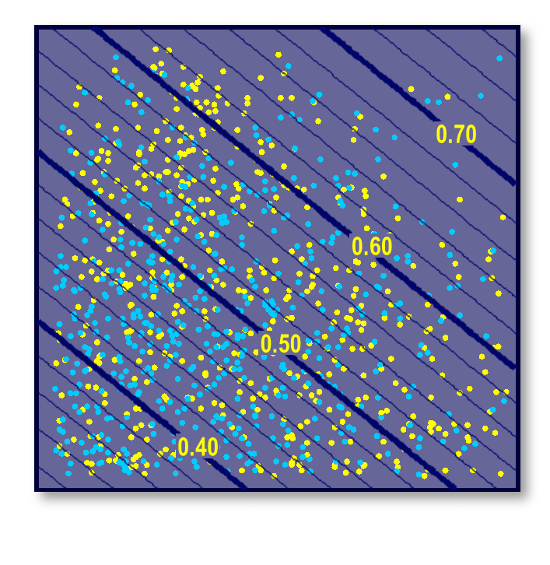
Standard Logistic Regression
^
p
1 – p
(
)
1.0
log
^
^
^
= w₀ + w₁ x₁ + w₂ x₂
^
·
·
0.9
0.8
0.7
0.6
x₂
0.5
0.4
0.3
0.2
0.1
0.0
0.0
0.1
0.2
0.3
0.4
0.5
0.6
0.7
0.8
0.9
1.0
x₁

Slide 68



Polynomial Logistic Regression
^
p
1 – p
(
)
1.0
log
^
^
^
0.80
= w₀ + w₁ x₁ + w₂ x₂
^
·
·
0.9
0.8
0.70
^
^
+ w₃ x₁ + w₄ x₂
²
²
0.7
0.60
+ w₅ x₁ x₂
0.6
x₂
0.5
quadratic terms
0.4
0.3
0.2
0.1
0.30
0.40
0.50
0.60
0.70
0.0
0.0
0.1
0.2
0.3
0.4
0.5
0.6
0.7
0.8
0.9
1.0
x₁
...

